Slide 1
Clustering Advanced Machine Learning
Data Science at Zindua School | By Chris Aloo

Slide 2
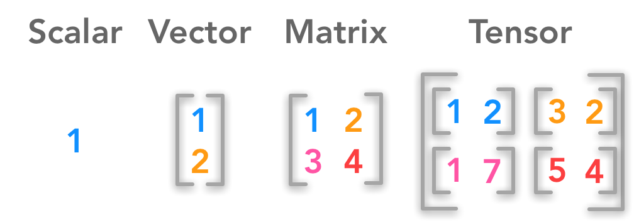
Brain Teaser
?
?

Slide 3
Brain Teaser

Slide 4
Introduction to Clustering

Slide 5
Introduction to Clustering
Unsupervised Learning Models
What is Clustering
Types of Clustering Models
Partitioning/Centroid Based
Hierarchical
Density Based
Distribution Based
Applications of Clustering
Notion of Similarity/Distance
Statistical Distance
Semantic Similarity
Evaluation Metrics

Slide 6
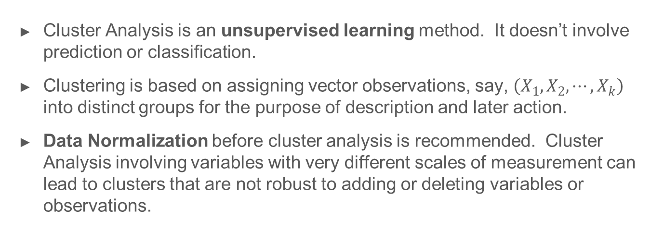
What is Clustering
Cluster Analysis is an unsupervised learning method. It doesn’t involve prediction or classification.
Clustering is based on assigning vector observations, say, $\left(X_{1}, X_{2}, ⋯, X_{k}\right)$ into distinct groups for the purpose of description and later action.
Data Normalization before cluster analysis is recommended. Cluster Analysis involving variables with very different scales of measurement can lead to clusters that are not robust to adding or deleting variables or observations.

Slide 7
Types of Clustering Models
Types of Clustering Models
Partitioning/Centroid Based : K-Means
Hierarchical : Divisive, Agglomerative
Density Based : DBSCAN, DENCLUE
Distribution Based : Gaussian Mixture Models (GMM)
Choosing the Right Model : Considerations
Data Shape and Data Distribution
Number of Clusters
Computational Resources
Interpretability
Presence of Outliers
Desired Cluster Characteristics

Slide 8
Application of Clustering

Slide 9
K-Means Clustering

Slide 10
Steps in the Algorithm

Slide 11
Steps in the Algorithm

Slide 12
Summary of K-Means Algorithm
Easy to use
Need to know K
May need to scale data
Good initial method
Local optima
No guarantee of optimal solution
Repeat with different starting values

Slide 13
K-means Lab

Slide 14
Hierachical Clustering

Slide 15
Key Concepts
Agglomerative vs Divisive
Dendrogram
Distance Similarity Matrix
Linkage Criteria
In Hierarchical Clustering, final clusters are built following a distinct set of sequential steps. Let’s explore this further (Next Slide)
a partition P1 into 1 clusters (the entire collection)
a partition P2 into 2 clusters
…
…
a partition Pn into n clusters (each object forms its own cluster)
The user decides which of the partitions reflects actual sub-populations in the data.

Slide 16
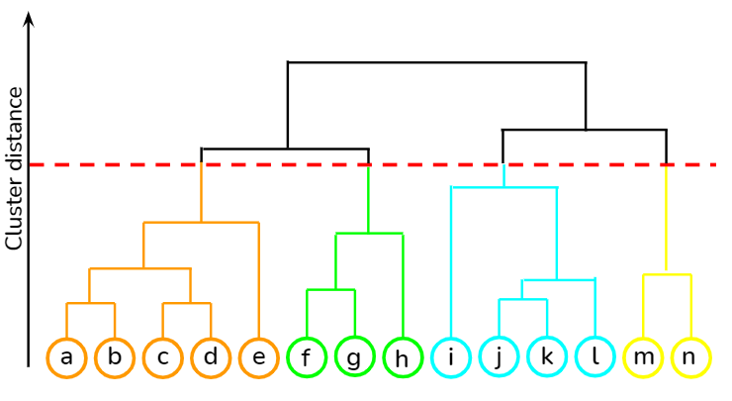




Hierarchical Cluster - Example

Slide 17
Agglomerative vs Divisive
Hierarchical methods again come in two varieties, agglomerative and divisive.
Agglomerative methods:
Start with partition Pn, where each object forms its own cluster.
Merge the two closest clusters, obtaining Pn-1.
Repeat merge until only one cluster is left.
Divisive methods
Start with P1.
Split the collection into two clusters that are as homogenous (and as different from each other) as possible.
Apply splitting procedure recursively to the clusters.

Slide 18
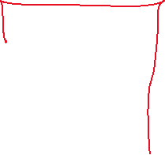

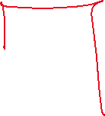
Dendrogram
ID | X1 | X2
1 | 5 | 6
2 | 10 | 9
3 | 3 | 4
4 | 4 | 8
1
4
3
2

Slide 19
Distance Similarity Matrix
Using Euclidean Distance
d(1,2) = [(5-10) ² +(6-9)²]^{1/2}
d(1,3) = [(5-3) ² +(6-4)²]^{1/2}
d(1,4) = [(5-4) ² +(6-8)²]^{1/2}
ID | X1 | X2
1 | 5 | 6
2 | 10 | 9
3 | 3 | 4
4 | 4 | 8
ID | 1 | 2 | 3 | 4
1 | 0
2 |  | 0
3 |  |  | 0
4 |  |  |  | 0

Slide 20
Distance Similarity Matrix
Using Euclidean Distance
d(1,2) = [(5-10) ² +(6-9)²]^{1/2}
d(1,3) = [(5-3) ² +(6-4)²]^{1/2}
d(1,4) = [(5-4) ² +(6-8)²]^{1/2}
ID | X1 | X2
1 | 5 | 6
2 | 10 | 9
3 | 3 | 4
4 | 4 | 8
ID | 1 | 2 | 3 | 4
1 | 0
2 | 5.83 | 0
3 | 2.8 | 8.6 | 0
4 | 2.2 | 6.1 | 4.1 | 0

Slide 21
Distance Similarity Matrix
Using Centroid Linkage
Centre (4,1) = [(5+4)/2, (6+8)/2)] = (4.5,7)
d((4,1),2) = [(5-10) ² +(6-9)²]^{1/2}
ID | X1 | X2
1 | 5 | 6
2 | 10 | 9
3 | 3 | 4
4 | 4 | 8
ID | 4,1 | 2 | 3
4,1 | 0
2 | 5.9 | 0
3 | 3.35 | 8.6 | 0
ID | 4,1,3 | 2
4,1,3 | 0
2 | 7.5 | 0

Slide 22
Linkage Criteria
Many variants to defining closest pair of clusters
Single-link
Similarity of the most cosine-similar (single-link)
Complete-link
Similarity of the “furthest” points, the least cosine-similar
Centroid
Clusters whose centroids (centers of gravity) are the most cosine-similar
Average-link
Average cosine between pairs of elements

Slide 23
Single Linkage
Use maximum similarity of pairs:
Can result in “straggly” (long and thin) clusters due to chaining effect.
After merging c_{i} and c_{j}, the similarity of the resulting cluster to another cluster, c_{k}, is:

Slide 24
Complete Linkage
Use minimum similarity of pairs:
Makes “tighter,” spherical clusters that are typically preferable.
After merging c_{i} and c_{j}, the similarity of the resulting cluster to another cluster, c_{k}, is:
C_{i}
C_{j}
C_{k}

Slide 25
Summary of Hierarchical Clustering
Questions to ask
How do you calculate the distance between clusters
How do you tell which clusters are near each other
Which points do you use
Advantages
Easier to Implement
Do not require one to specify the number of clusters
Dendrogram can be used to understand results
Disadvantages
Not Efficient for Large Datasets
Does not produce the same results each time it is run, due to random initialization of centroids

Slide 26
Computational Complexity
In the first iteration, all HAC methods need to compute similarity of all pairs of N initial instances, which is O(N²).
In each of the subsequent N−2 merging iterations, compute the distance between the most recently created cluster and all other existing clusters.
In order to maintain an overall O(N²) performance, computing similarity to each other cluster must be done in constant time.
Often O(N³) if done naively or O(N² log N) if done more cleverly

Slide 27
Hierarchical Clustering Lab
Check Out this Site for illustration of Hierarchical Clustering

Slide 28
Denisity Based Scan (DBSCAN)

Slide 29
Density-Based Clustering Methods
Clustering based on density (local cluster criterion), such as density-connected points or based on an explicitly constructed density function
Major features:
Discover clusters of arbitrary shape
Handle noise
One scan
Need density parameters
Several interesting studies:
DBSCAN: Ester, et al. (KDD’96)
DENCLUE: Hinneburg & D. Keim (KDD’98/2006)
OPTICS: Ankerst, et al (SIGMOD’99).
CLIQUE: Agrawal, et al. (SIGMOD’98)

Slide 30
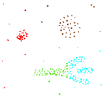
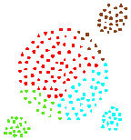
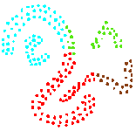
Density-based Approaches
Why Density-Based Clustering methods?
Discover clusters of arbitrary shape.
Clusters – Dense regions of objects separated by regions of low density
DBSCAN – the first density-based clustering
OPTICS – density-based cluster-ordering
DENCLUE – a general density-based description of cluster and clustering
Why Density-Based Clustering?
Results of a k-medoid algorithm for k=4

Slide 31
Density-Based Clustering Methods
DBSCAN is a density-based algorithm.
Density = number of points within a specified radius r (Eps)
A point is a core point if it has more than a specified number of points (MinPts) within Eps
These are points that are at the interior of a cluster
A border point has fewer than MinPts within Eps, but is in the neighborhood of a core point
A noise point is any point that is not a core point or a border point.

Slide 32
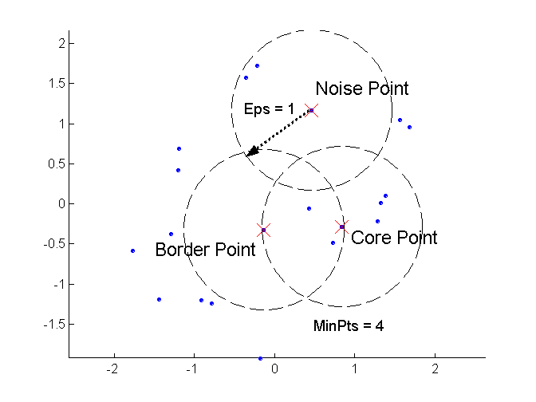
DBSCAN: Core, Border, and Noise Points
Outlier
Border
Core
ε = 1unit, MinPts = 5

Slide 33
DBSCAN Algorithm (simplified view for teaching)
Create a graph whose nodes are the points to be clustered
For each core-point c create an edge from c to every point p in the ε-neighborhood of c
Set N to the nodes of the graph;
If N does not contain any core points terminate
Pick a core point c in N
Let X be the set of nodes that can be reached from c by going forward;
create a cluster containing X∪{c}
N=N/(X∪{c})
Continue with step 4
Remark: points that are not assigned to any cluster are outliers;

Slide 34






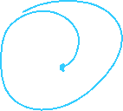


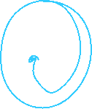










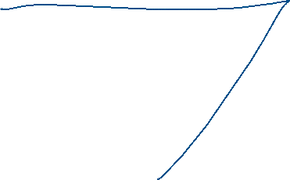
Steps in the Algorithm

Slide 35
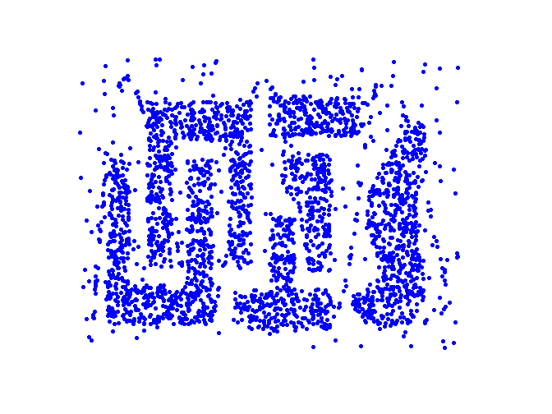
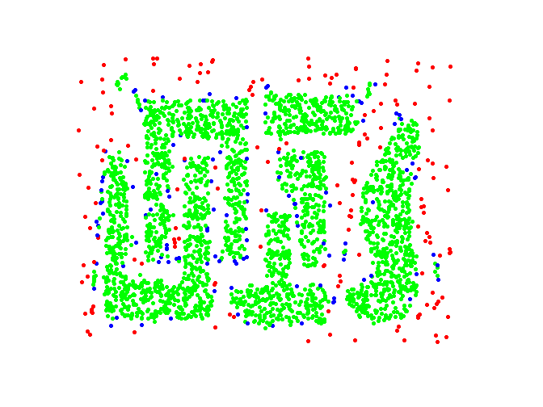
DBSCAN: Core, Border and Noise Points
Original Points
Point types: core, border and noise
Eps = 10, MinPts = 4

Slide 36
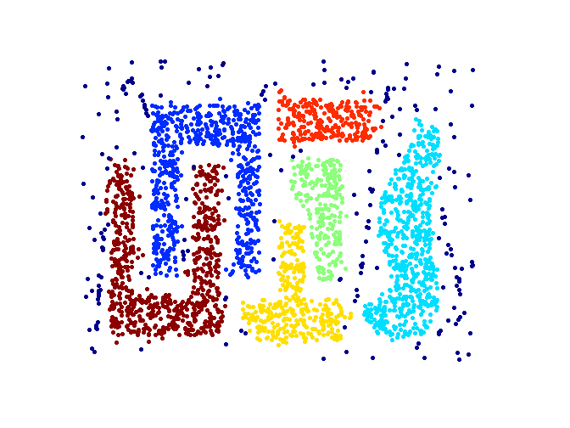
When DBSCAN Works Well
Clusters
Resistant to Noise
Can handle clusters of different shapes and sizes

Slide 37
When DBSCAN Works Well
Clusters
Resistant to Noise
Can handle clusters of different shapes and sizes

Slide 38
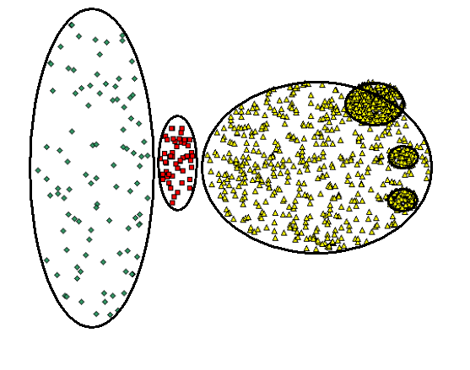
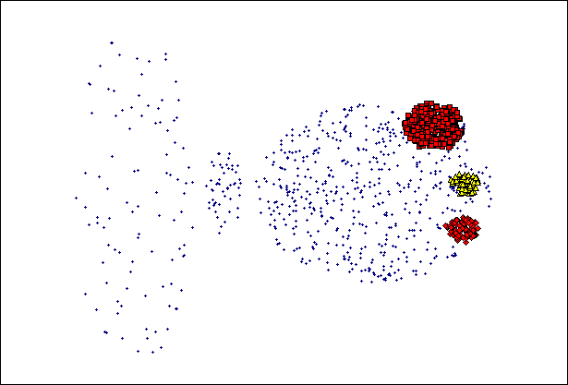
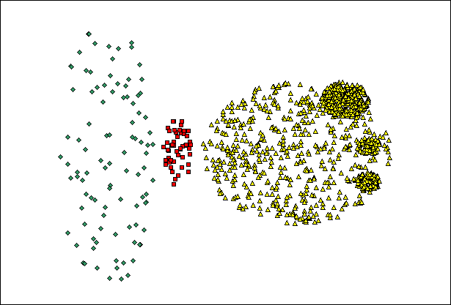
When DBSCAN Does NOT Work Well
(MinPts=4, Eps=9.75).
Original Points
(MinPts=4, Eps=9.92)
Varying densities
High-dimensional data

Slide 39
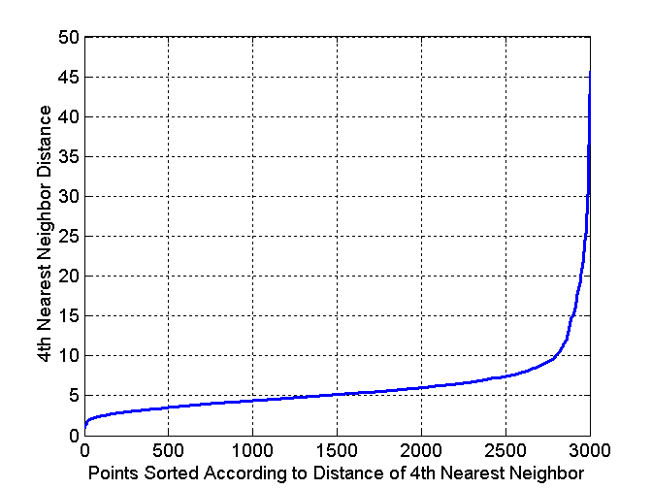
DBSCAN: Determining EPS and MinPts
Idea is that for points in a cluster, their k^{th} nearest neighbors are at roughly the same distance
Noise points have the k^{th} nearest neighbor at farther distance
So, plot sorted distance of every point to its k^{th} nearest neighbor
Run K-means for Minp=4 and not fixed
Core-points
Non-Core-points

Slide 40
Complexity DBSCAN
Time Complexity: O(n²)—for each point it has to be determined if it is a core point, can be reduced to O(n*log(n)) in lower dimensional spaces by using efficient data structures (n is the number of objects to be clustered);
Space Complexity: O(n).

Slide 41
Summary of DBSCAN
Good: can detect arbitrary shapes, not very sensitive to noise, supports outlier detection, complexity is kind of okay, beside K-means the second most used clustering algorithm.
Bad: does not work well in high-dimensional datasets, parameter selection is tricky, has problems of identifying clusters of varying densities (→SSN algorithm), density estimation is kind of simplistic (→does not create a real density function, but rather a graph of density-connected points)

Slide 42
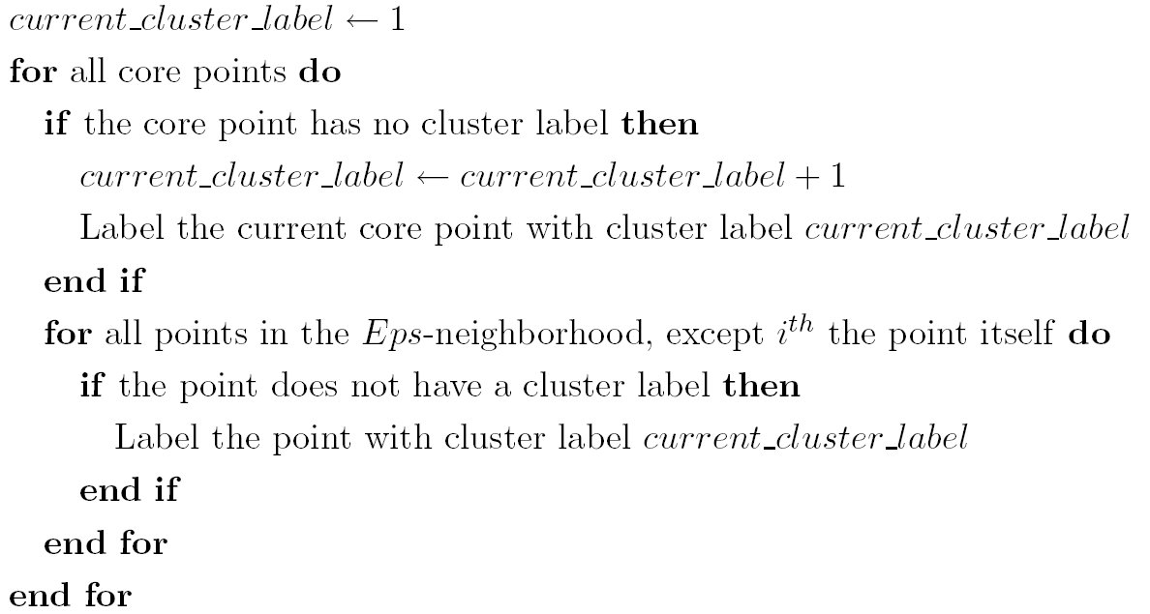
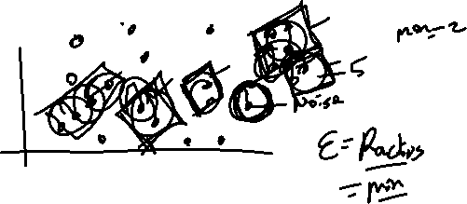
Summary of DBSCAN
Eliminate noise points
Perform clustering on the remaining points:

Slide 43
DBSCAN Lab
Check Out this Site for Implementation of DBSCAN with different shapes

Slide 44
Density Estimation

Slide 45
Key Concepts

Slide 46
Gaussian Mixture Models (GMM)

Slide 47
Key Concepts

Slide 48
When to Use GMMs

Slide 49
GMMs Lab

Slide 50
Key Concepts

Slide 51
When to Use GMMs

Slide 52
GMMs Lab

Slide 53
Clustering Performance Evaluation

Slide 54
Clustering Evaluation Metrics

Slide 55
End…

